Slide 1


Project Preview with Wells Fargo
UNC CHARLOTTE
ITAI 4160 & 5160 Databases and Cloud for Artificial Intelligence
October 28 · College of Health & Human Serv 380
Notes:
Welcome Ken and the room. Explain that every team presents to the whole room in sequence, six minutes each with a one-minute changeover.

Slide 2
GUEST REVIEWERS & STRATEGIC ADVISORY
Today's Executive Guests from Wells Fargo
PENDING AVAILABILITY
Vanessa Vreeland
Ken Meyer
CIO of Enterprise Functions Technology
Venture Capital & Private Equity Partner / Corporate Development Executive
Enterprise Cloud & Data Infrastructure,
Tech Strategy
Financial AI Integration
(Joining pending availability)
25+ Years
2 Programs
VC, PE & Corporate Dev Experience
Bank Venture & PE Programs Launched
Strategic Growth: Evaluating startup scalability & market positioning
Investment Lens: Venture capital pitching and enterprise strategy
Entrepreneurship: Founder of independent venture capital firm
Leading today's strategic review, project feedback, and Q&A sessions.
Note: Attendance subject to availability today.

Slide 3
Brief group check-ins
SESSION FORMAT
Every team presents to the whole room and the industry reviewer(s), one after another.
7
6 + 0.5
45
Teams
Minutes per team on average
Minutes total
Each with a one-pager and a key discussion question
Six on stage, one to switch over
7 teams × 7 minutes
UNC Charlotte · Project Preview with Wells Fargo
2
Notes:
Seven teams, seven minutes each including the changeover, forty-nine minutes in total.

Slide 4
Pitch, demo, then discussion
INSIDE EACH TEAM’S SIX MINUTES
1 min
2-3 min
3 min
The 60-second pitch
Screen or artifact demo
CIO feedback and discussion
Show the system architecture diagram and a working pipeline or database query.
Jump straight to the team’s key discussion question
State the problem, target impact and core tech stack.
UNC Charlotte · Project Preview with Wells Fargo
3
Notes:
The bar is drawn to scale: half of each team’s time goes to the conversation with Ken.

Slide 5
Presentation order
Order | Team | Project
1 | Josiah Duran, Raymundo Munoz Cuevas, Ali Chaaraoui, Essey Beraki | FitWise AI: Personalized Gym Coaching & Algorithmic Workout Prescriptions
2 | Josh Marsico, Jayden Parsons, Himaja Goda, Michael Simms | Financial Literacy Service: AI-Powered Market Context for Beginner Investors
3 | Akshat Kumar, Caleb Richardson, Jackson Redman, Scott Do | ClassWizard
4 | Smriti Bhemireddy, Connor Kelly, Andrew Gallegos Garcia, Rithvik Gottumukkala, Dash Doubleday | S-Card: Personalized Spam Protection
5 | Mujtaba Ali Khan, Cayman Powell, Alexis Arenas-Villalba | CoursePilot: AI Academic Advising Assistant
6 | Alec Pike, Ryan Brown, Eric Medlock, Justin MacCreery | RAEJ: LLM Translation for Languages Without Parallel Data
7 | Sana Shaik, Sahir Shaik, Shreem Dixit, Dias Utebekov | From MCP Server Discovery to Explainable Security Risk Intelligence
4
Notes:
SSH Tunneling to our Private Cloud (Internal Use)
ssh -L 5176:cci-cluster1-node0:5176 -L 8606:cci-cluster1-node0:8606 cci-jump
ssh -L 5173:cci-cluster1-node0:5173 -L 8605:cci-cluster1-node0:8605 cci-jump
ssh -L 18501:cci-cluster1-node0:8501 -L 18000:cci-cluster1-node0:8000 cci-jump
ssh -L 8680:cci-cluster1-node0:8680 cci-jump
ssh -L 13680:cci-cluster1-node0:13680 cci-jump
ssh -L 18001:cci-cluster1-node0:18001 cci-jump
ssh -L 18507:cci-cluster1-node0:18507 cci-jump

Slide 6

Transition to Team: FitWise AI
Ali Chaaraoui · Josiah Duran · Raymundo Munoz Cuevas · Essey Beraki
Time to wrap up
Notes:
Timekeeper card. Print it or show it on a phone or tablet when a team hits five minutes.

Slide 7
FitWise AI
TEAM 6 · THE 60-SECOND PITCH
Ali Chaaraoui · Josiah Duran · Raymundo Munoz Cuevas · Essey Beraki
THE PROBLEM
TARGET IMPACT
CORE TECH STACK
Beginners get generic plans that ignore their gym’s equipment, so many quit early.
Every exercise doable at your own gym, with where to find it, and one-tap swaps.
Python · FastAPI · React · PostgreSQL + MongoDB · Docker → k3s
Team 6 · Minute 0:00–1:00
10
Notes:
One speaker, 60 seconds. FitWise is a workout coach for people who are new to the gym. Most beginners get a generic plan that doesn't know what equipment their gym has or where it is, so they wander around, feel lost, and a lot of them stop going. FitWise starts from the user's real gym. We loaded the UNC Charlotte Rec Center with its zones and equipment. Every day it builds a beginner full-body workout using only what that gym has and tells you where each machine is. If a machine is taken, one tap swaps in an exercise for the same muscles. If you say your knee is sore, it remembers and drops knee-heavy exercises until you say it's better. It runs on FastAPI and React, with PostgreSQL for the gym, users and that memory, and MongoDB for an 876-exercise library, in Docker Compose and moving to the class k3s cluster.

Slide 8
System architecture
TEAM 6 · DEMO - Current Sprint Progress & Early Baseline
DEMO
GIT REPO
FITWISE · DOCKER COMPOSE TODAY → K3S CLUSTER (PLANNED)
APP
AI LAYER
DATA
User
Frontend · React
TODAY
NEXT
MongoDB
:5176 · what the user sees
876 exercises + stress tags
on their phone
Workout planner
LLM check-ins
gym gear + injuries
Ollama · Sprint 3
→ safe plan by zone
Vector search
Backend · FastAPI
Semantic Memory
embeddings · Sprint 3
:8606 · the API
Check-in reader
pgvector · Sprint 3
check-in · today
swap · log workout
text → dated facts
Smarter swaps
PostgreSQL
rule-based today
gym · users · facts · workouts
embeddings · Sprint 4
DATA PIPELINE · SPRINT 4
Fitbit + exercise files + gym walkthrough → PySpark: bronze → silver → gold → PostgreSQL
Solid = running today · Dashed = planned · FitWise plans a beginner's workout from their real gym and what they've told it.
11
11
Notes:
Two minutes. Show the diagram for a few seconds: the browser loads the React frontend, the FastAPI backend reads the gym and the user's active injuries from PostgreSQL and the exercise library from MongoDB. Then switch to localhost:5173. 1) Today's workout: six exercises, each with its zone in the Rec Center. 2) Tap Taken? on one card: it swaps to the same muscle on different equipment. 3) Post the check-in 'My knee is sore today' and reload: squats are gone and the reason line mentions the knee. Before the session: run docker compose up, clear any old knee fact with the check-in 'My knee feels better now', and have the browser and terminal open.

Slide 9
“At what scale should we split workouts, wearable data and embeddings into dedicated stores?”
TEAM 6 · Industry Guest Feedback & Q&A
Three minutes
Team 6 · Minute 3:00–6:00
12
Notes:
Three minutes with executive guests. Context if he asks: today PostgreSQL holds the gym, users, temporal facts and Fitbit daily metrics; MongoDB holds the exercise library; embeddings are planned in pgvector. Backup question from our one-pager: our forecasts will give a goal date with a confidence range. How does Wells Fargo present uncertain predictions so customers trust them without over-relying on them?

Slide 10
Transition to Team: Financial Literacy
Josh Marsico, Himaja Goda, Jayden Parsons, Michael Simms
Time to wrap up
Notes:
Timekeeper card. Print it or show it on a phone or tablet when a team hits five minutes.

Slide 11
Financial Literacy Service
TEAM 5 · THE 60-SECOND PITCH
Josh Marsico, Himaja Goda, Jayden Parsons, Michael Simms
THE PROBLEM
TARGET IMPACT
CORE TECH STACK
Doing your own market research means pulling together news, price history, and the vocabulary to read it. For someone new to investing, that effort is the barrier.
Confident, informed new investors who understand what they’re looking at before they make a decision.
Python + FastAPI · PostgreSQL + pgvector · Docker · React
Team 5 · Minute 0:00–1:00
10
Notes:
Optional title card each team can show while the pitch is spoken. One speaker, sixty seconds.

Slide 12
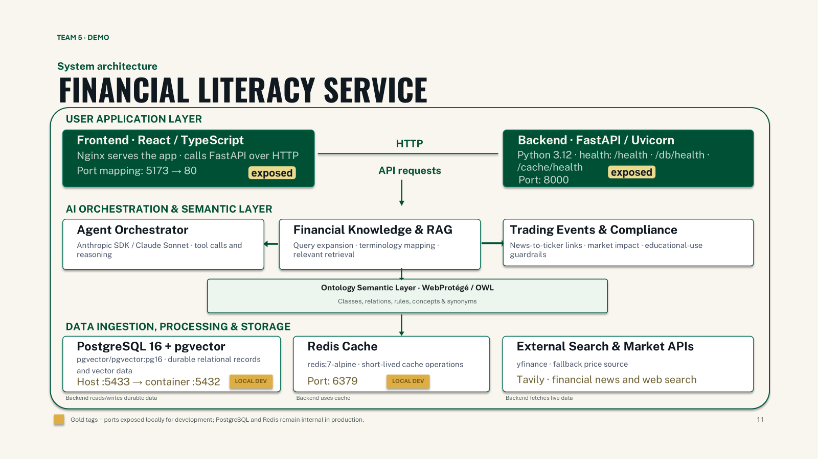
- Current Sprint Progress & Early Baseline
DEMO
GIT REPO
11
Notes:
Show the diagram for a few seconds, then cut to the working pipeline or query. Two minutes.

Slide 13
“What governance, audit logging, and human-review controls should be in place before an AI system presents financial-news explanations to customers?”
TEAM 5 · Industry Guest Feedback & Q&A
Team 5 · Minute 3:00–6:00
12
Notes:
Leave this on screen for the whole discussion so the question stays in front of the room.

Slide 14
Transition to Team: ClassWizard
Akshat Kumar, Caleb Richardson, Jackson Redman, Scott Do
Time to wrap up
Notes:
Timekeeper card. Print it or show it on a phone or tablet when a team hits five minutes.

Slide 15
ClassWizard
TEAM 4 · THE 60-SECOND PITCH
Akshat Kumar, Caleb Richardson, Jackson Redman, Scott Do
THE PROBLEM
TARGET IMPACT
CORE TECH STACK
Students do not guidance for which classes give skills that link to their desired career
UNC Charlotte students graduate with career-ready skills
Python · Docker · Redis
PostgreSQL + pgvector
Open-Source LLM
Team 4 · Minute 0:00–1:00
10
Notes:
Optional title card each team can show while the pitch is spoken. One speaker, sixty seconds.

Slide 16
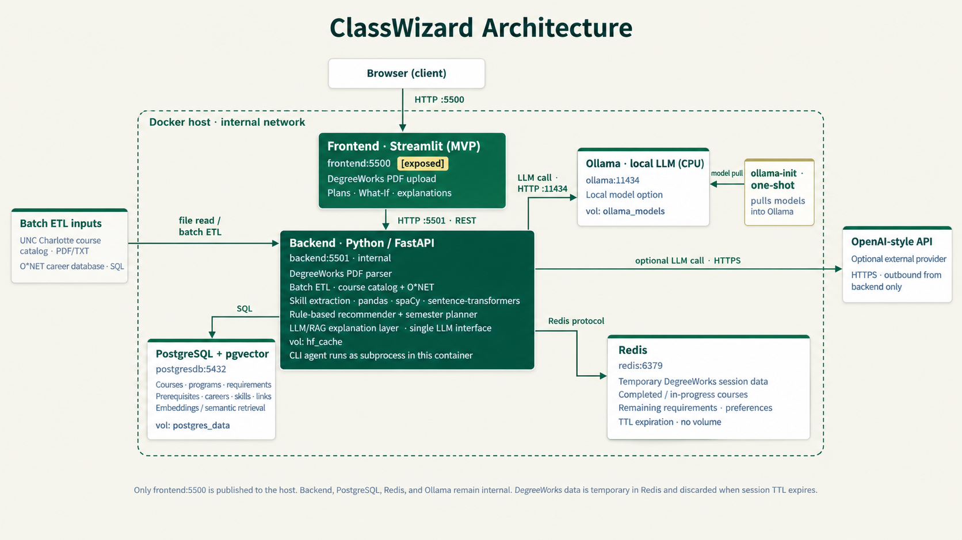

System architecture
TEAM 4 · DEMO - Current Sprint Progress & Early Baseline
DEMO
GIT REPO
THEN SWITCH TO LIVE
Upload a Degreeworks PDF → select a career → view results
[Paste architecture diagram here]
Have it open in a tab before your turn starts.
Sources → pipeline → storage → output
Team 4 · Minute 1:00–3:00
11
Notes:
Show the diagram for a few seconds, then cut to the working pipeline or query. Two minutes.

Slide 17
“How can organizations protect sensitive data when integrating information from internal system into data analytics and AI applications?”
TEAM 4 · Industry Guest Feedback & Q&A
Three minutes
Team 4 · Minute 3:00–6:00
12
Notes:
Leave this on screen for the whole discussion so the question stays in front of the room.

Slide 18
Transition to Team: S-Card
Andrew Gallegos Garcia, Connor Kelly, Rithvik Gottumukkala, Smriti Bhemireddy, Dash Doubleday
Time to wrap up
Notes:
Timekeeper card. Print it or show it on a phone or tablet when a team hits five minutes.

Slide 19


TEAM 7 · THE 60-SECOND PITCH
S-Card
Andrew Gallegos Garcia, Connor Kelly, Rithvik Gottumukkala, Smriti Bhemireddy, Dash Doubleday
THE PROBLEM
TARGET IMPACT
CORE TECH STACK
People receiving text messages face spam, while aggressive filtering can hide important alerts.
Goals: flag fewer than 1% of legitimate SMS and complete local checks in under 100 milliseconds.
JavaScript, Python/FastAPI, PostgreSQL and Docker.
Team 7 · Minute 0:00–1:00
10
Notes:
Hi Ken. I'm Andrew, with Connor, Rithvik, Smriti and Dash. We're Team 7, and our project is S-Card. Spam interrupts people, but aggressive filtering can also hide a bank alert or verification code. Our prototype checks pasted English text messages in the browser. Users choose how cautious the filter should be, set messages aside, restore them and save corrections locally. Private message text stays on the device. Our targets are to flag fewer than one percent of legitimate messages and complete local checks in under one hundred milliseconds. These are goals we still need to validate on current messages and devices. We use JavaScript, Python, PostgreSQL and Docker. Dash will show the architecture, then we'll demonstrate a message check and the database evidence behind our two filtering profiles.

Slide 20
TEAM 7 · DEMO - Current Sprint Progress & Early Baseline
System architecture
DEMO
GIT REPO
HTTP :8080 for the application, model download and public API requests
Docker Compose network: scard
User browser
frontend:8080 · Nginx
▶
Serves the app and model.json; published at 127.0.0.1:8080; only exposed service
HTTP /api reverse proxy
LIVE DEMO
Local TF-IDF / logistic-regression inference
▼
backend:8000 · Python/FastAPI
Local message check, quarantine and restore
Internal public-data API and importer; health and readiness endpoints
IndexedDB for quarantine and exact-message corrections
SQL: evaluation_summary
▼
PostgreSQL protocol / SQL
postgres:5432 · PostgreSQL 17
postgres_data
Compare spam caught and legitimate messages flagged
localStorage for the selected profile
Internal database; stores public messages, dataset splits, model metadata and evaluation results
Named volume for persistent public research data
Planned k3s deployment
Frontend and backend Deployments with internal Services · Traefik TLS ingress exposes the frontend only · Backend connects to instructor-provided shared PostgreSQL · Database persistence uses platform-managed storage/PVC · Instructor finalizes deployment and coordinated ports
11
Team 7 · Minute 1:00–3:00
Notes:
Connor operates the laptop throughout. 1:00-1:20 Dash explains the architecture, ports and persistence; switch to the live app afterward. 1:20-1:45 Connor selects Protect important messages, loads the prize example and checks it; scoring runs locally and the score is uncalibrated. 1:45-2:10 Smriti explains quarantine, restore and exact-message corrections while Connor demonstrates; corrections do not retrain the model; browser storage is not encrypted by this app. 2:10-3:00 Rithvik runs Recall and false positives by profile in Public data & SQL; show an additional public false-positive example only if time permits.
Verified historical test results: 1,032 test messages: 128 spam and 904 legitimate. Cautious profile: 111 spam caught, 5 legitimate flagged, 86.72% spam recall, 0.55% false-positive rate. More aggressive profile: 118 spam caught, 19 legitimate flagged, 92.19% recall, 2.10% false-positive rate. The aggressive profile catches seven additional spam while flagging fourteen additional legitimate messages. These describe historical public SMS and do not establish production or mobile performance. CSV and JSON artifacts are packaged files.

Slide 21
TEAM 7 · Industry Guest Feedback & Q&A
How should organizations balance response time, device battery life, data privacy, and cost when deciding whether an AI application should run locally or use cloud-based inference?
What level of false positives would a bank consider acceptable before piloting this system with customers, and what safeguards and remediation processes should be in place when errors occur?
Three minutes
Team 7 · Minute 3:00–6:00
12
Notes:
Andrew asks Question 1, pauses for Ken's response, then asks Question 2 as time allows. Reserve minutes 3:00–6:00 for discussion.

Slide 22
Transition to Team: CoursePilot
Cayman Powell, Mujtaba Khan, Alexis Arenas-Villalba
Time to wrap up
Notes:
Timekeeper card. Print it or show it on a phone or tablet when a team hits five minutes.

Slide 23
TEAM 8 · THE 60-SECOND PITCH
UNC Charlotte Course Pilot
Cayman Powell, Mujtaba Khan, AlexisArenas-Villalba
THE PROBLEM
TARGET IMPACT
CORE TECH STACK
UNC Charlotte students navigate multiple sources for course requirements and degree planning, causing confusion and repeated advising requests.
Faster answers to academic questions, accurate source-backed guidance, and fewer routine advising requests. Metrics will be evaluated during testing.
Implemented: Python/FastAPI, React/Next.js, PostgreSQL, Docker
Planned: RAG, vector search, LLM integration
Team 8] · Minute 0:00–1:00
10

Slide 24
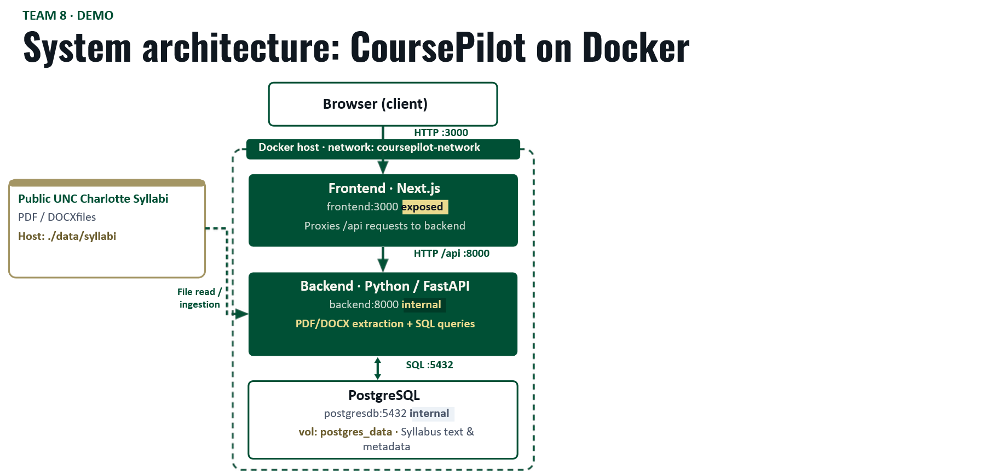
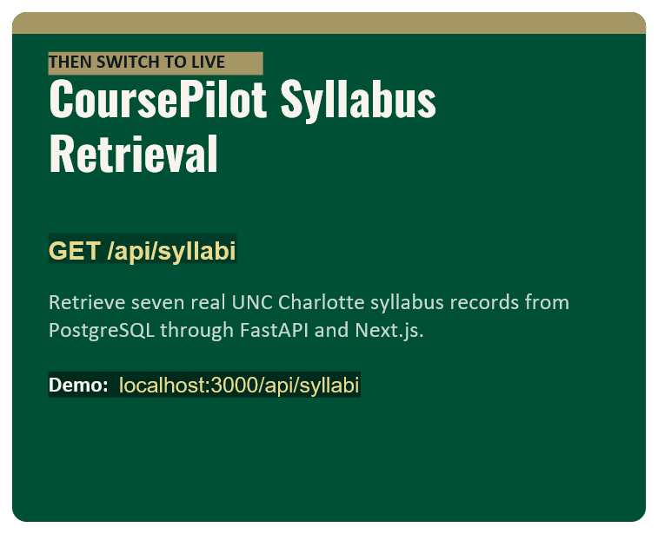
- Current Sprint Progress & Early Baseline
DEMO
GIT REPO
Notes:
ssh -L 13680:cci-cluster1-node0:13680 cci-jump

Slide 25
TEAM 8 · Industry Guest Feedback & Q&A
“What’s the best way to balance the managed cloud services with a containerized deployment without having to sacriﬁce student uploads and with the ability to keep source traceability”
Three minutes
Team 8 · Minute 3:00–6:00
12

Slide 26
Transition to Team: RAEJ
Alec Pike · Ryan Brown · Eric Medlock · Justin MacCreery
Time to wrap up
Notes:
Timekeeper card. Print it or show it on a phone or tablet when a team hits five minutes.

Slide 27
RAEJ: Translating Languages No LLM Knows
TEAM 1 · THE 60-SECOND PITCH
Alec Pike · Ryan Brown · Eric Medlock · Justin MacCreery
THE PROBLEM
TARGET IMPACT
CORE TECH STACK
Thousands of low-resource languages and conlangs have a dictionary and a grammar but no parallel text, so standard machine translation can't serve them
Accuracy on a 25-sentence validated gold set, and prompt tokens per request: RAG vs. the full ~28k-token context.
Python · FastAPI · PostgreSQL + pgvector · LangChain · spaCy · Nomic Embed · LM Studio / Ollama / OpenAI API · Docker
Team 1 · Minute 0:00–1:00
10
Notes:
Optional title card each team can show while the pitch is spoken. One speaker, sixty seconds.

Slide 28
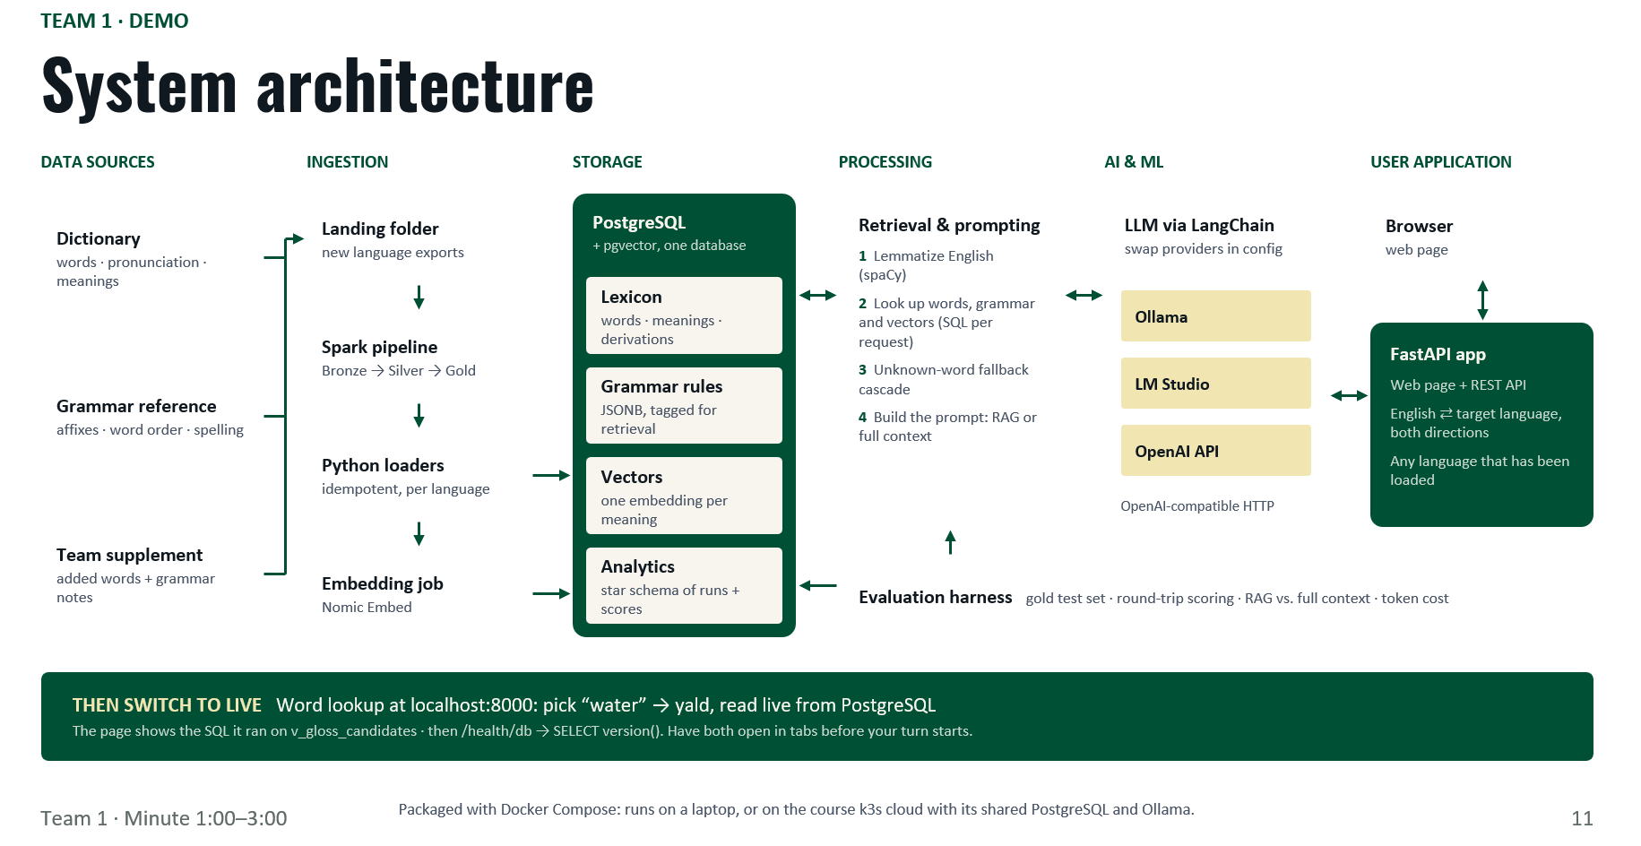
- Current Sprint Progress & Early Baseline
DEMO
GIT REPO
Notes:
Show the diagram for about 20 seconds. Two services run in Docker Compose on network app_net: python-app (FastAPI, port 8000, the only piece the browser talks to) and postgres (PostgreSQL 16 + pgvector, port 5432, data in the postgres_data volume). The app queries Postgres over SQL. Ingestion scripts load the Yopowi dictionary and grammar into Postgres. Dashed parts are Sprint 3: the evaluation harness and the LLM call, which goes over HTTP to one provider set in .env (Ollama, LM Studio on the Mac mini, or the OpenAI API). On the class k3s cloud, PostgreSQL/pgvector and Ollama map to the shared platform services. Then switch to the live lookup: pick 'water', show yald and the SQL that ran, then /health/db. Have both open in tabs before the turn starts.

Slide 29
“As context windows grow from thousands to millions of tokens, is it still worth the complexity to use RAG? How do you evaluate and decide?”
TEAM 1 · Industry Guest Feedback & Q&A
Three minutes
Team 1 · Minute 3:00–6:00
12
Notes:
Leave this on screen for the whole discussion so the question stays in front of the room.

Slide 30
Transition to Team: MCP Sentinel
Sana Shaik, Shreem Dixit, Sahir Shaik, Dias Utebekov
Time to wrap up
Notes:
Timekeeper card. Print it or show it on a phone or tablet when a team hits five minutes.

Slide 31
MCP Sentinel AI-Powered Security Intelligence for MCP Servers
TEAM 2 · THE 60-SECOND PITCH
Sana Shaik, Shreem Dixit, Sahir Shaik, Dias Utebekov
THE PROBLEM
TARGET IMPACT
CORE TECH STACK
Organizations evaluating third-party MCP servers lack a unified view of known vulnerabilities and missing security evidence.
50% faster initial MCP security reviews through centralized evidence, server comparisons, and explainable risk intelligence.
Python · Streamlit · FastAPI · PostgreSQL 17 · Docker Compose · MCP Registry · OSV.dev · deps.dev
Team 2 · Minute 0:00–1:00
10
Notes:
Optional title card each team can show while the pitch is spoken. One speaker, sixty seconds.

Slide 32
System architecture
TEAM 2 · DEMO - Current Sprint Progress & Early Baseline
DEMO
Screenshots
DOCKER COMPOSE · MCP SENTINEL
GIT REPO
BROWSER / USER
HTTP :8501 · public
SAVED DATA
frontend · Streamlit
THEN SWITCH TO LIVE
GitHub · npm / PyPI · MCP Registry · deps.dev · OSV · Agora · tools
frontend:8501 · EXPOSED
LLM use
Search “praisonai” → inspect version-matched advisories and sources → compare an assessed server with one that has not been assessed.
HTTP
Evidence-grounded
AI explanations
backend · FastAPI
backend:8000 · INTERNAL
Ollama
importer · Python
internal
SQL
on demand · SQL
db · PostgreSQL 17
OpenAI API
db:5432 · INTERNAL
external
Prompt + response
Live Streamlit demo · localhost:8501
AI explanations via Ollama/OpenAI: planned.
volume: postgres_data
Team 2 · Minute 1:00–3:00
11
Notes:
Show the diagram for a few seconds, then cut to the working pipeline or query. Two minutes.

Slide 33
“When a third-party MCP server has no known vulnerabilities but hasn't been fully assessed, what evidence and safeguards should a bank require before approving it?”
TEAM 2 · Industry Guest Feedback & Q&A
Three minutes
Team 2 · Minute 3:00–6:00
12
Notes:
Leave this on screen for the whole discussion so the question stays in front of the room.

Slide 34
THANK YOU!
UNC CHARLOTTE · PROJECT PREVIEW SESSION
Next Step: Sprints 3 & 4 ⇒ Final Session on Nov. 30
Dr. Qiong Cheng · qcheng1@charlotte.edu
Notes:
Thank Ken and give teams one clear next step.

